Slide 1
Firearm Registration Correlated to State Crime and Social Statistics Data
Dream Team
Team Leader: Gene
Mike
Ted
Enerel
GW_Data Analytics BootCamp
July, 2019

Slide 2
Facts
Gun violence in the United States results in thousands of deaths and injuries each year.
The US currently has the most gun-related murders per 100,000 people in the developed world, at a little over 3 gun murders per 100,000 people (CDC, 2015).
In 2017 alone, 11 mass shootings in the US caused 117 fatalities and 587 injuries occurring in concert, religious, workplace, airport, and shopping venues and in the community.
On June 12, 2016 at Pulse Nightclub, a single shooter killed 49 people and injured 53. It was the worst mass shooting in US history until the mass shooting in Las Vegas in October 2017 took 58 lives and left 546 injured.
Approximately one of three handguns guns is kept loaded and unlocked and most children know where their parents keep their guns.
In 2015, 2,824 children (age 0 to 19 years) died by gunshot and an additional 13,723 were injured.
According to the CDC, threre were 1,555 firearm fatalities in Pennsylvania in 2016.

Slide 3
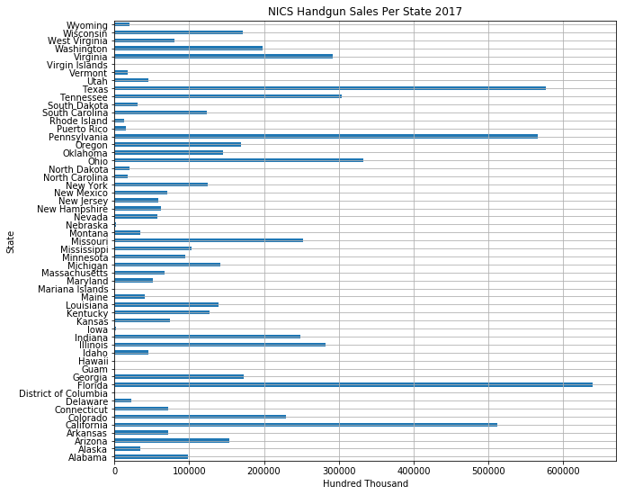
NICS Handgun Sales per State 2017

Slide 4
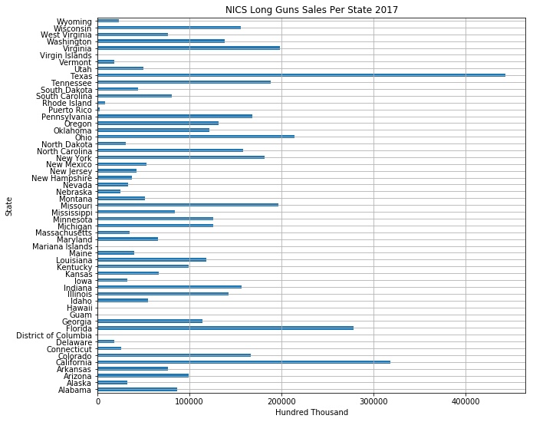
Line Graph of Gun Registration

Slide 5
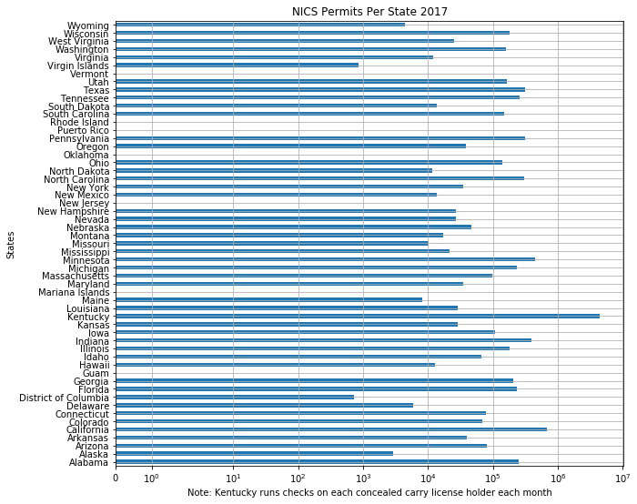
NICS Permits per State 2017

Slide 6
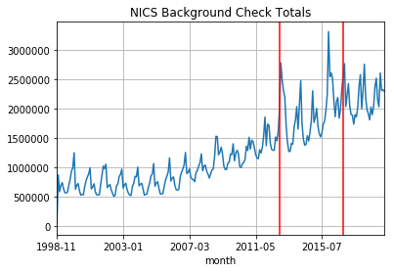
Line Graph of Gun Registration
Red lines correlate to 2012 and 2016 Presidential Election

Slide 7
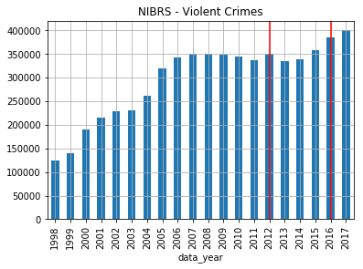
Plot the National Incident Based Reporting System (NIBRS) - Violent Crimes Data
Red lines correlate to 2012 and 2016 Presidential Election

Slide 8
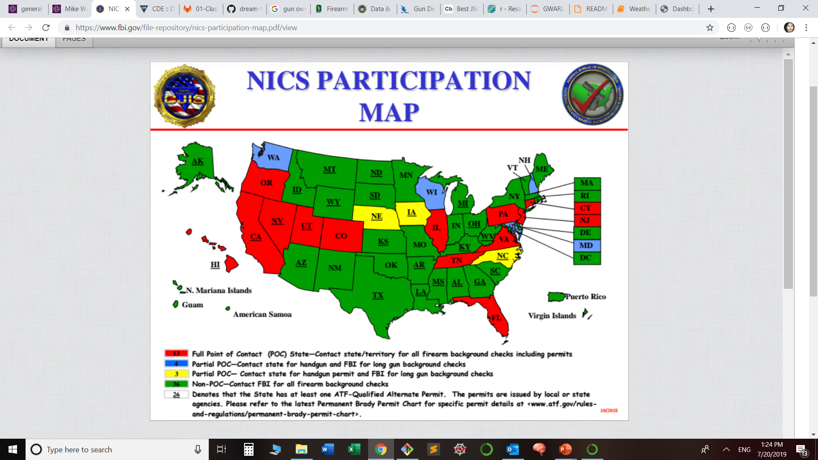
NICS Participation Map

Slide 9
References:
CDC (2015). Injury mortality reports 1999 and onwards (USA). In Web-based Injury Statistics Query and Reporting System / CDC WISQARS. Atlanta: National Center for Injury Prevention and Control, Centers for Disease Control and Prevention / CDC.

